Slide 1
MUSIC HOST INTERFACE
BEng. Hons. Computer And Electronic Engineering, GMIT
Student: Thomas Flynn
Supervisor: Brian O’ Shea

Slide 2
Contents
Background
Tools
JavaFX Media Player Application
Android Application
Summary
Conclusion

Slide 3
Background & Scoping
Personal
Demonstrate Abilities
Realization of Ideas
Initial Idea
Virtual Jukebox
Complete Idea
Music Host dictates what the guests can do.
The guest can...
-Request songs
-Skip songs
-Give the DJ feedback

Slide 4



Tools
JavaFX
Scene Builder
Media Player API
Animation API
Microsoft Azure Cloud Storage
User Login Credentials
User Songs
Bluetooth
BlueCove library
Android Bluetooth API

Slide 5
JavaFX Overview
JavaFX is intended to replace Swing as the standard GUI library for Java SE.
Swing interoperability. Existing Swing applications can be updated with new JavaFX features.
Graphic designers can easily customize the appearance and style of the application through CSS.
High-performance media engine.

Slide 6
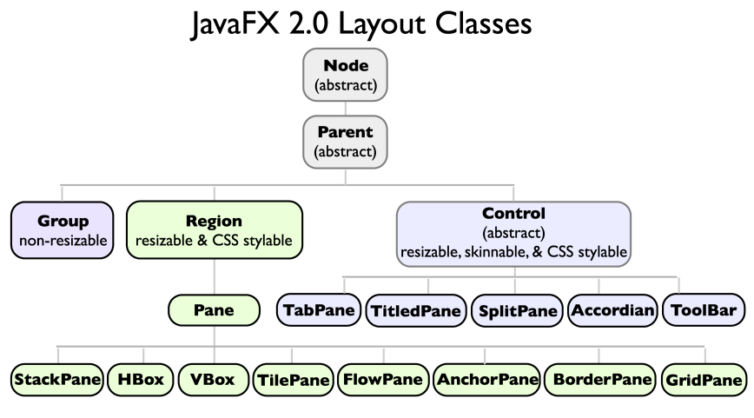
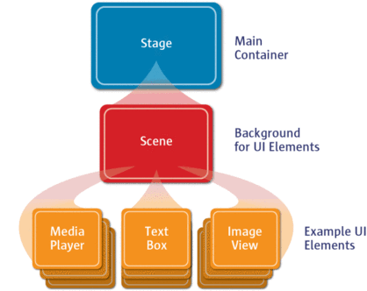
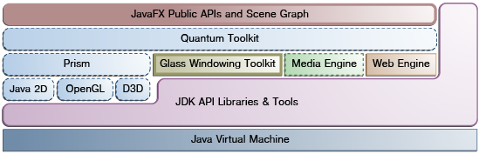
JavaFX Overview
Stage.
Scene Graph.
Node.
Includes graphics primitives.
JavaFX application thread.
Media thread.

Slide 7
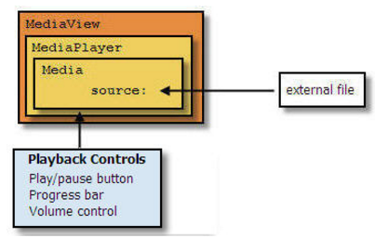
Media in javafx
Media classes are part of javafx.scene.media package.
Media, MediaPlayer and MediaView
MediaView is a Node, it has a MediaPlayer.
MediaPlayer has a Media object.
MediaTimers allow functions to be invoked at key points in Media.

Slide 8
FXML and Scene Builder
FXML is an XML-based declarative markup language for constructing a JavaFX application user interface.
A designer can code in FXML or use JavaFX Scene Builder to interactively design the graphical user interface (GUI).
Scene Builder generates FXML markup that can be ported to an IDE where a developer can add the business logic.

Slide 9
Microsoft Azure SQL Database
Cloud based service (DBaaS)
Special version of Microsoft SQL Server as its backend.
XML based format for data transfer.
T-SQL as the query language.
Tabular Data Stream (TDS) as the protocol to access the service over the Internet.

Slide 10
Microsoft Azure SQL Database
Minimum Driver Version: Microsoft JDBC Driver 4.0
Driver = com.microsoft.sqlserver.jdbc.SQLServerDriver
Server= jdbc:sqlserver://muzikhostserver.database.windows.net:1433;"
Database = FYP
User = thomas11811@muzikhostserver
Password = Zqlllx$8

Slide 11
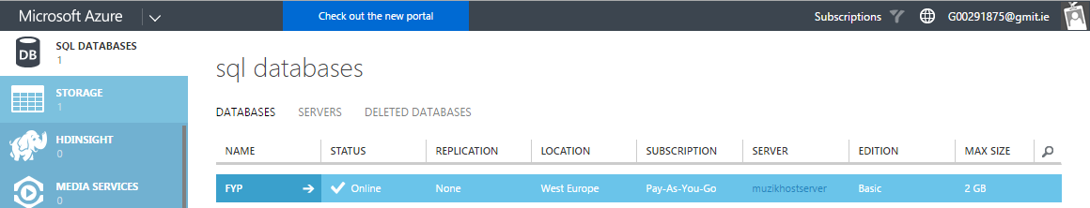
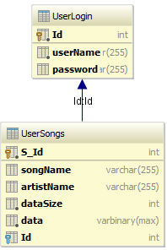
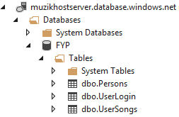
Microsoft Azure SQL Database
SQL Server
Database

Slide 12
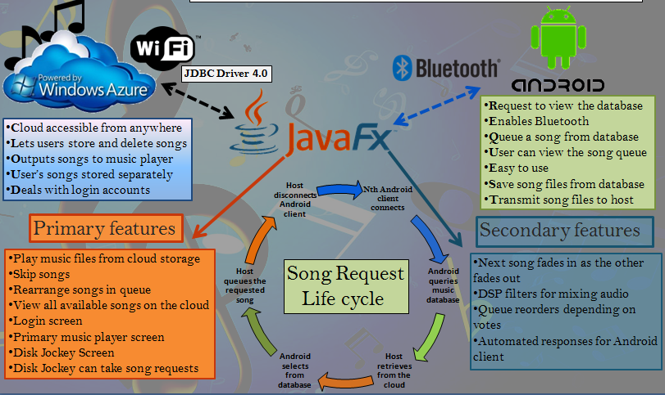
Christmas Poster

Slide 13
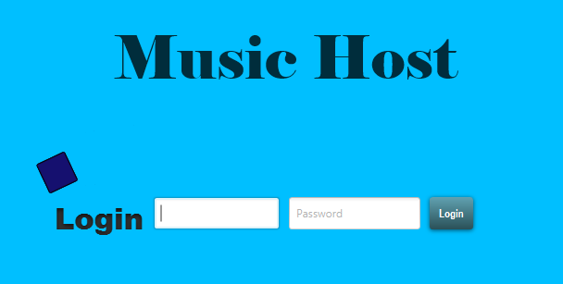
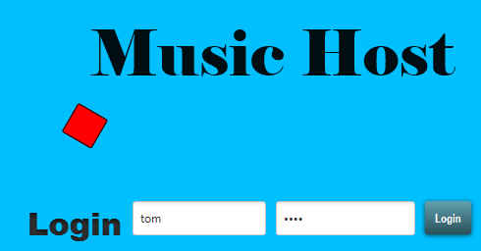
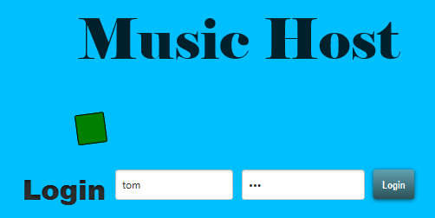
MEDIA PLAYER - LOGIN SCREEN
Login Credentials
Success/Fail
Animation
Login Button
Fail
Animation
Success
Animation

Slide 14
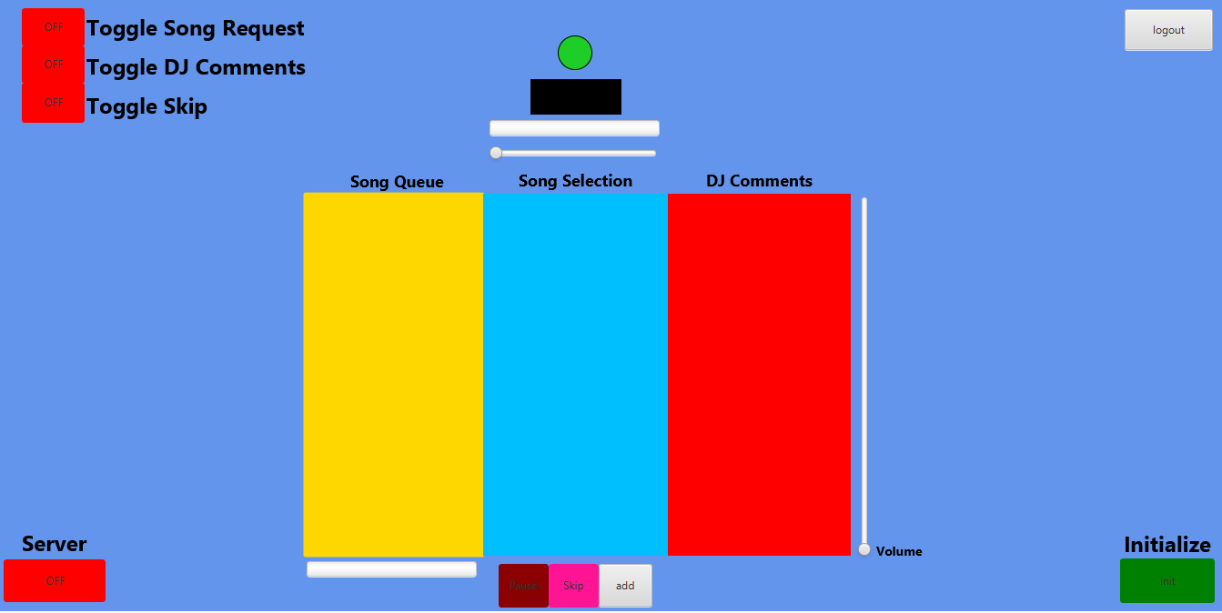
MEDIA PLAYER - MAIN SCREEN
Host Options
Logout Button
MediaView
Play Animation
Time Slider
Server Button
Download
Progress
Play, Skip, Add, Buttons
Volume Control
Start Button

Slide 15
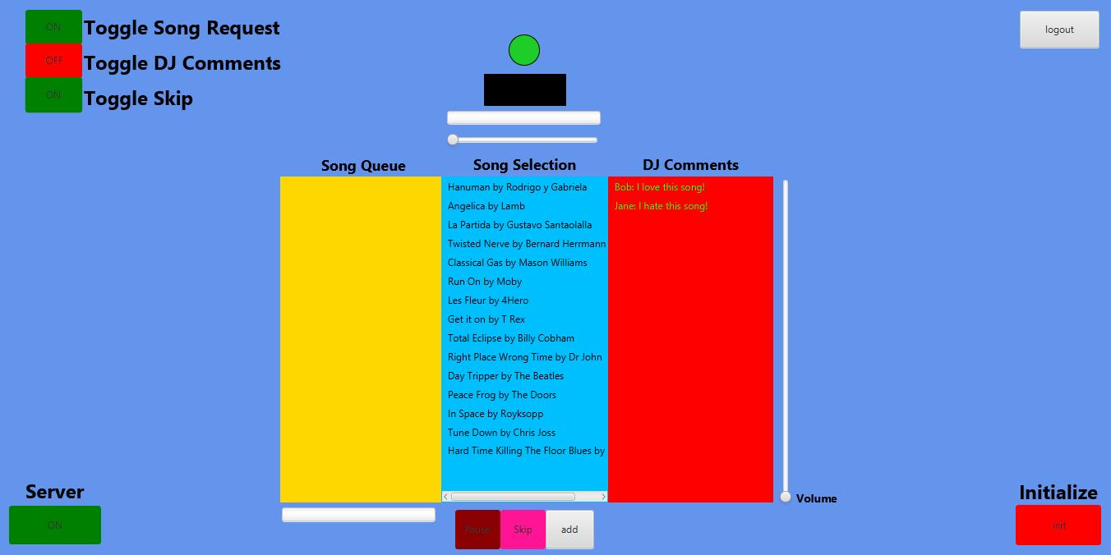
MEDIA PLAYER USE CASE – SETUP
Guest Options Specified
Server Enabled
Selection Populated
Initialized

Slide 16
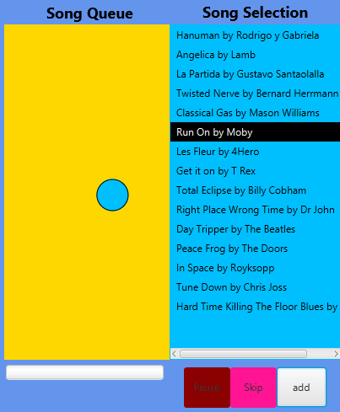
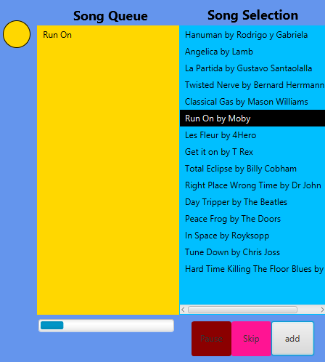
MEDIA PLAYER USE CASE - SONG ADDED
Animation Complete
Song added
Animation
Download Started
User Clicks

Slide 17
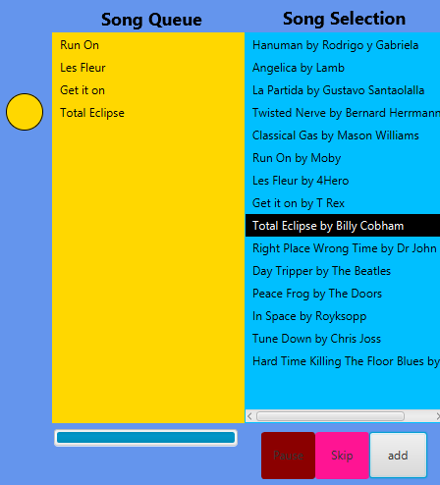
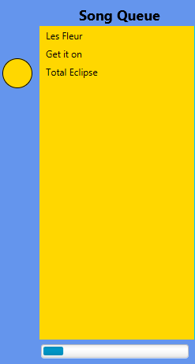
MEDIA PLAYER USE CASE - SONG SKIPPED / SONG ENDED
Next Song Plays
Circle Moves Up
Event Fired
Next Next Song Downloads

Slide 18
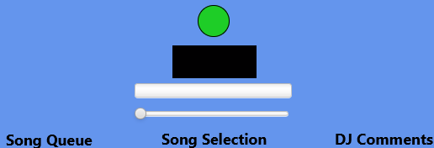
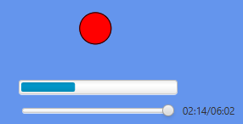
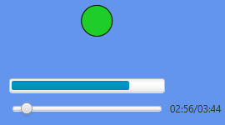
MEDIA PLAYER USE CASE – PLAY/PAUSE
Animation Not
Started
MediaView Empty
Animation Paused
Animation Playing

Slide 19
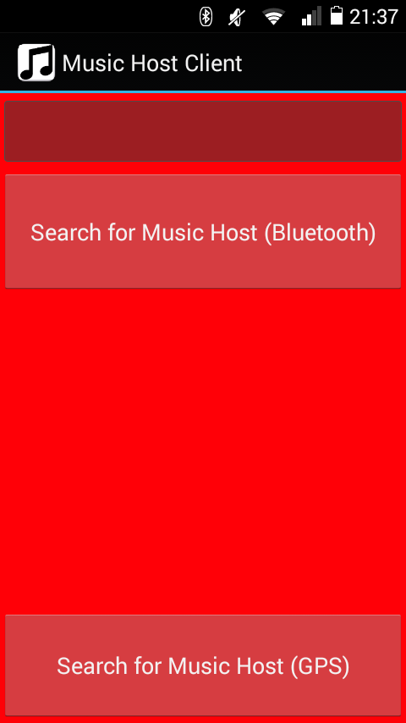
MUSIC HOST CLIENT USE CASE – OPEN APP
Edit TextField
DJ Comment
Button
BT Adaptor.startDiscovery
Song Request,
DJ Comment,
Skip Song
Invisible Buttons
Button
Azure Mobile Services

Slide 20
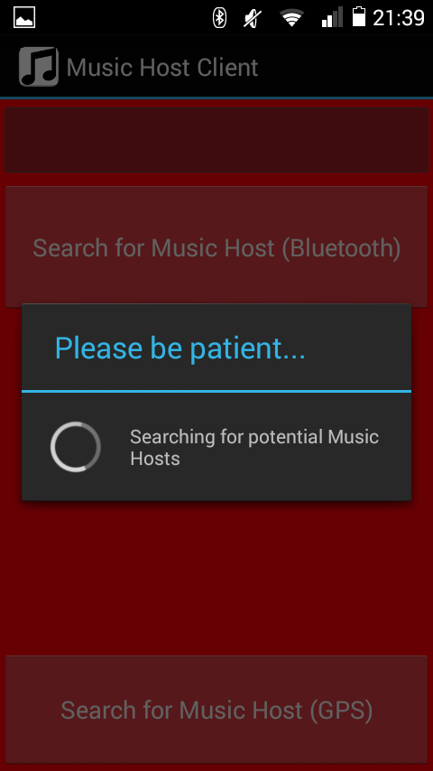
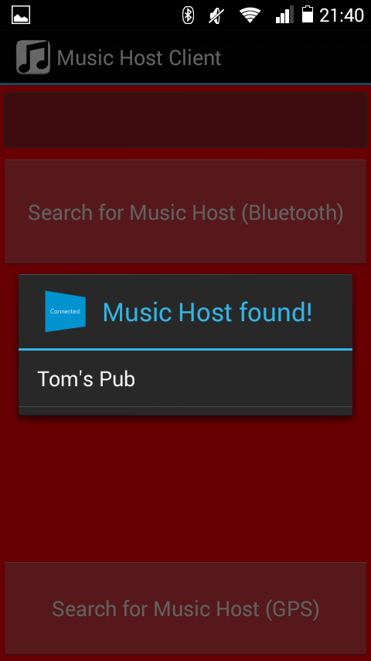
MUSIC HOST CLIENT USE CASE – SEARCH FOR MUSIC HOST (BT)
Music Host Found

Slide 21
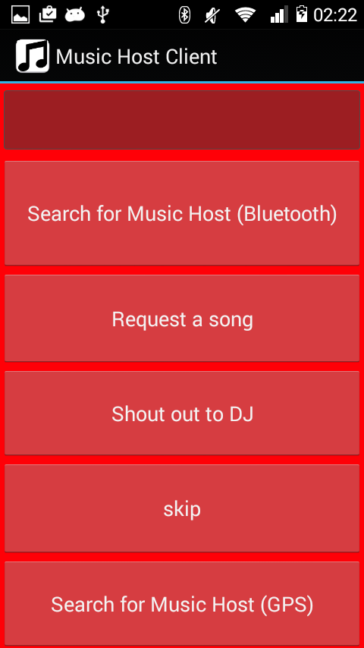
MUSIC HOST CLIENT USE CASE – Connected
Edit TextField
DJ Comment
Button
Send SONG_SELECT int
Button
Send DJ_COMMENT int
Button
Send SKIP_SONG int

Slide 22
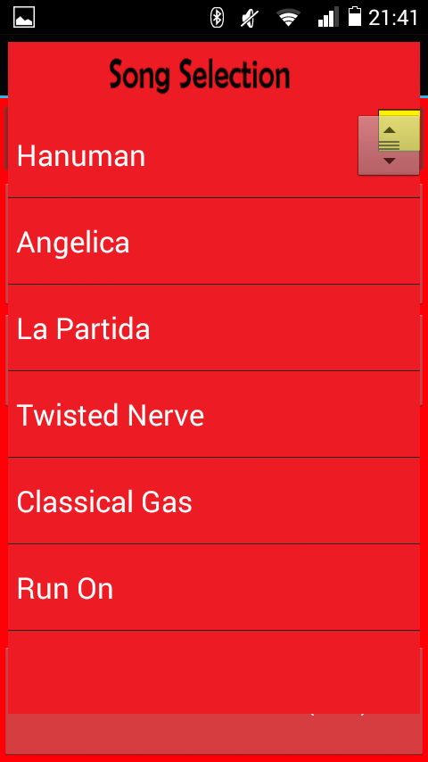
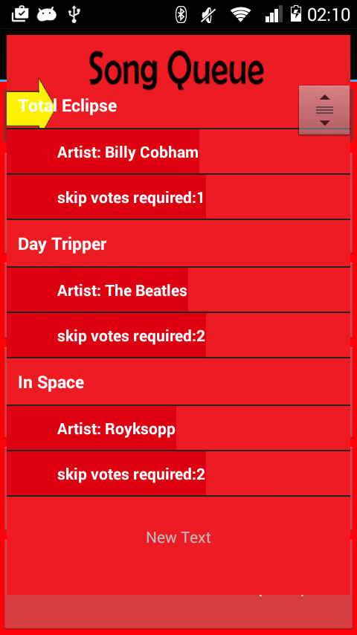
MUSIC HOST CLIENT USE CASE – SONG REQUEST
Selected
Song
Swipe
Left
Right
ViewFlipper Child 1
ViewFlipper Child 2

Slide 23
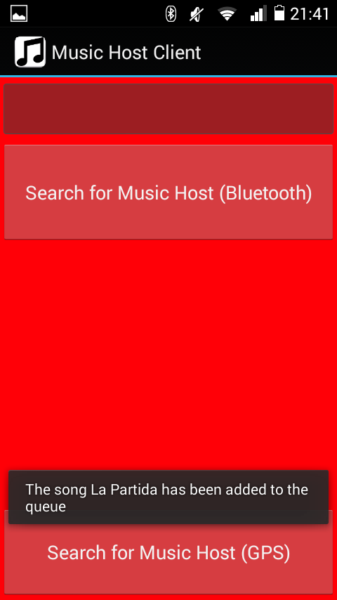
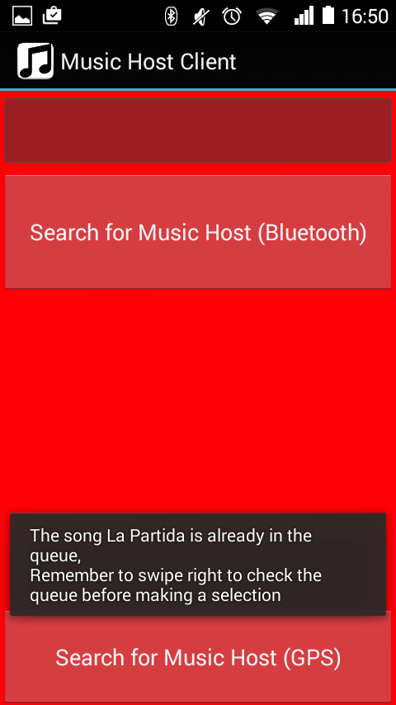
MUSIC HOST CLIENT USE CASE – SONG ACCEPTED / NOT ACCEPTED
Message From Host

Slide 24
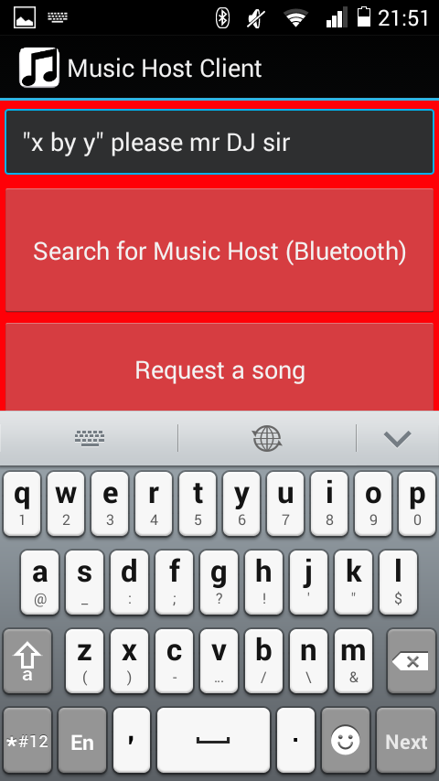
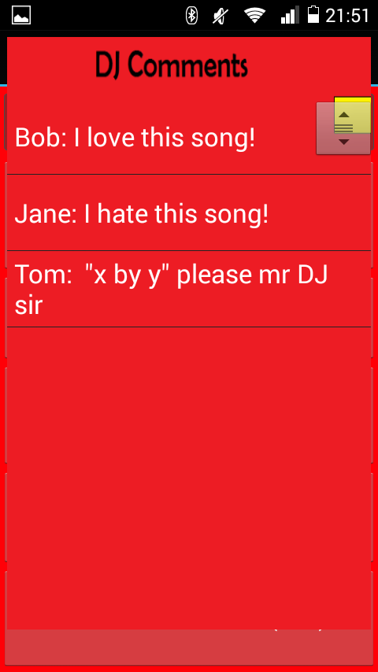
MUSIC HOST CLIENT USE CASE – DJ Comment
Button Clicked

Slide 25
MUSIC HOST CLIENT USE CASE – SKIP SONG
Skip votes required decremented
Button Clicked

Slide 26

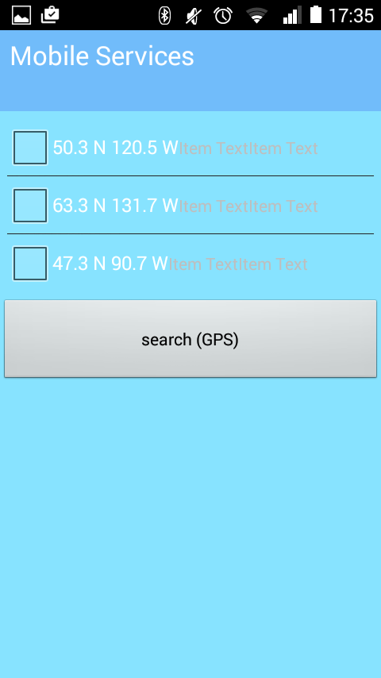
MUSIC HOST CLIENT USE CASE – SEARCH FOR MUSIC HOST (GPS)
Progress Widget
Search Button
GPS Coordinates
Result

Slide 27
Conclusion
Goals
Demonstration of abilities.
Pleasant user experience for both the host and guest.
Reflection
More focus on Client/Server Protocol.
Develop for local song files.
Develop for Wi-Fi instead of Bluetooth.
Conclusion
Project is a product of my abilities and personality.
The product is 50-100 more working hours away from being marketable.

Slide 28
References
github.com/acaicedo/JFX-MultiScreen
github.com/marcuspimenta/Chat-Bluetooth
bluecove.org
https://manage.windowsazure.com/gmit.ie#Workspaces/MobileServicesExtension/apps/MusicHostService/dashboard
https://manage.windowsazure.com/gmit.ie#Workspaces/SqlAzureExtension/SqlServer/muzikhostserver/Database/5.muzikhostserver/Dashboard

